Slide 1
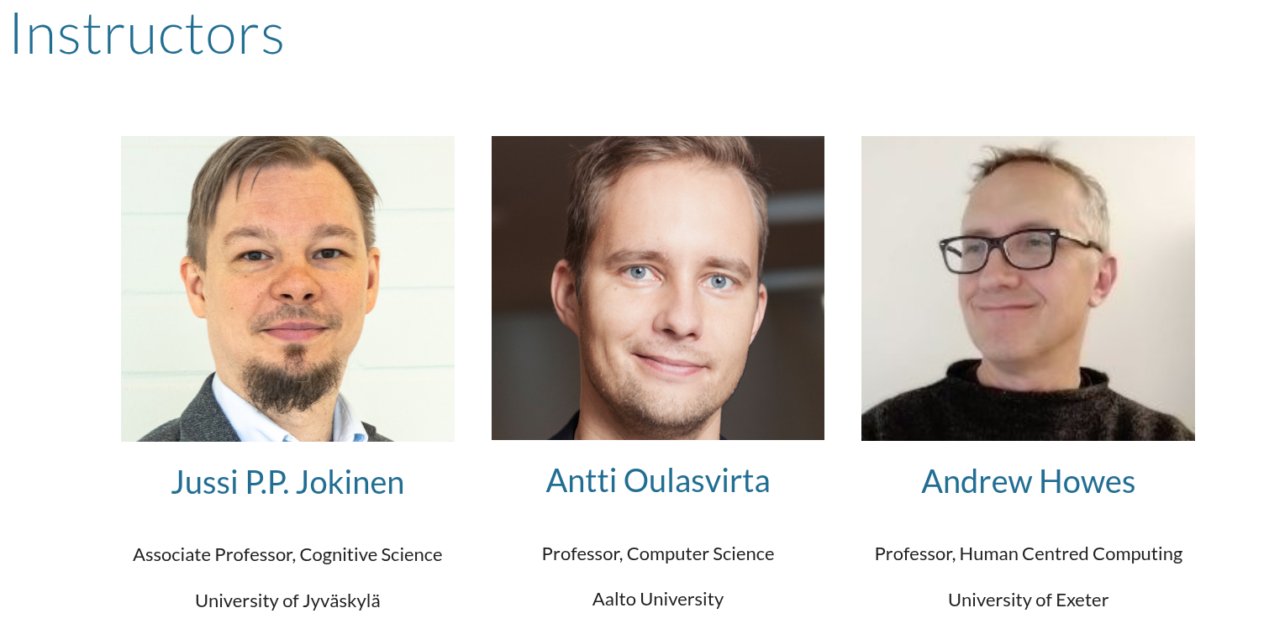

Slide 2
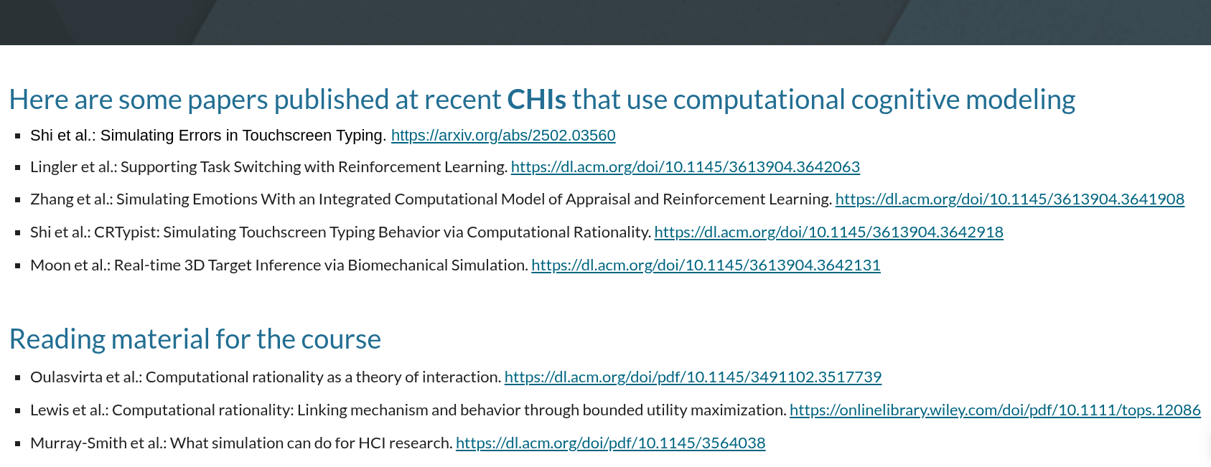

Slide 3
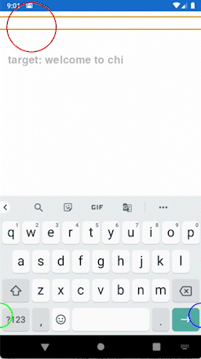
Shi et al. CHI’24, CHI’25

Slide 4
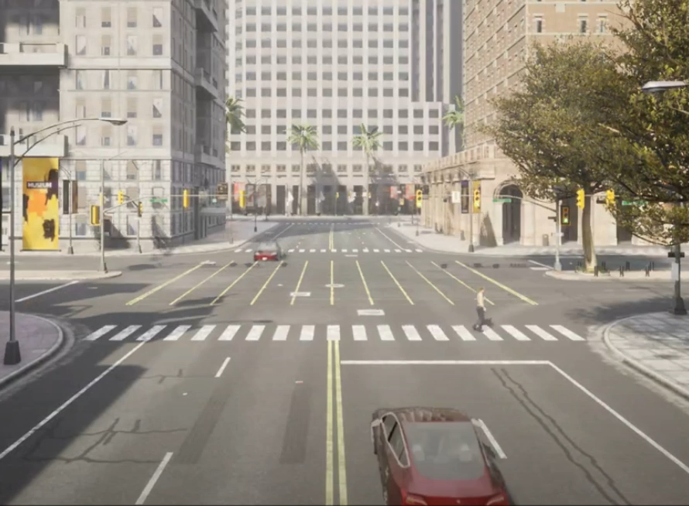

Slide 5
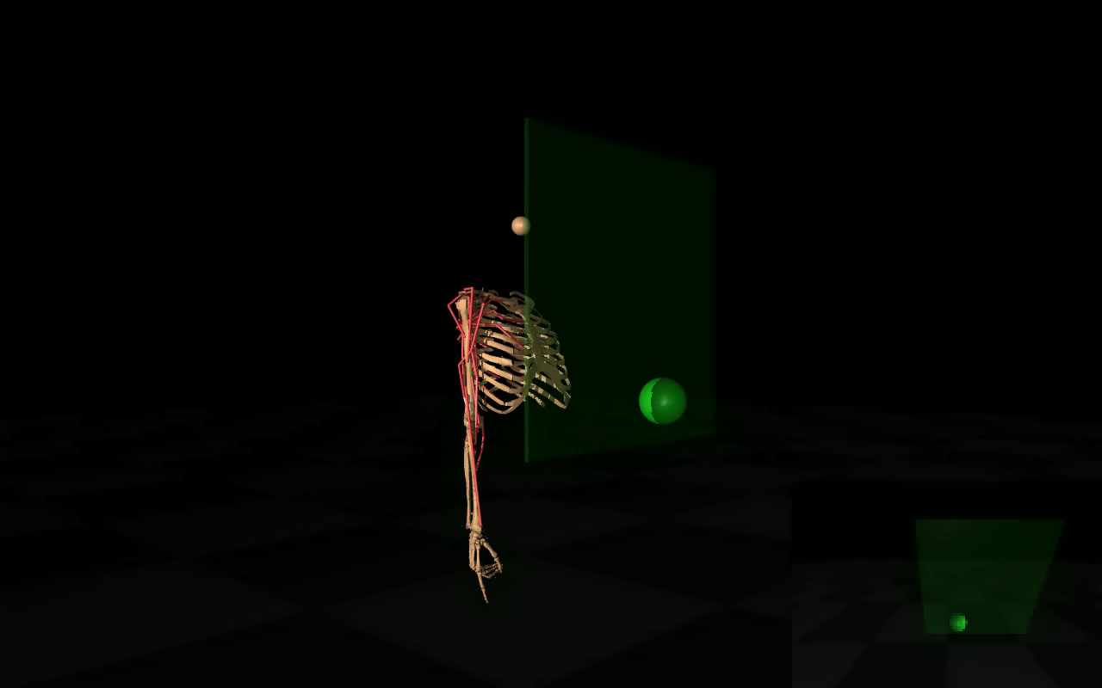
Ilkkala et al. UIST’22

Slide 6
computational cognitive modeling for HCI

Slide 7
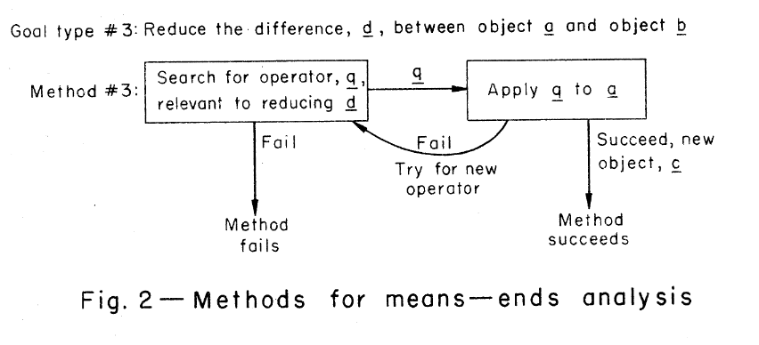
General problem solver GPS (Newell, Shaw, Simon 1958)

Slide 8
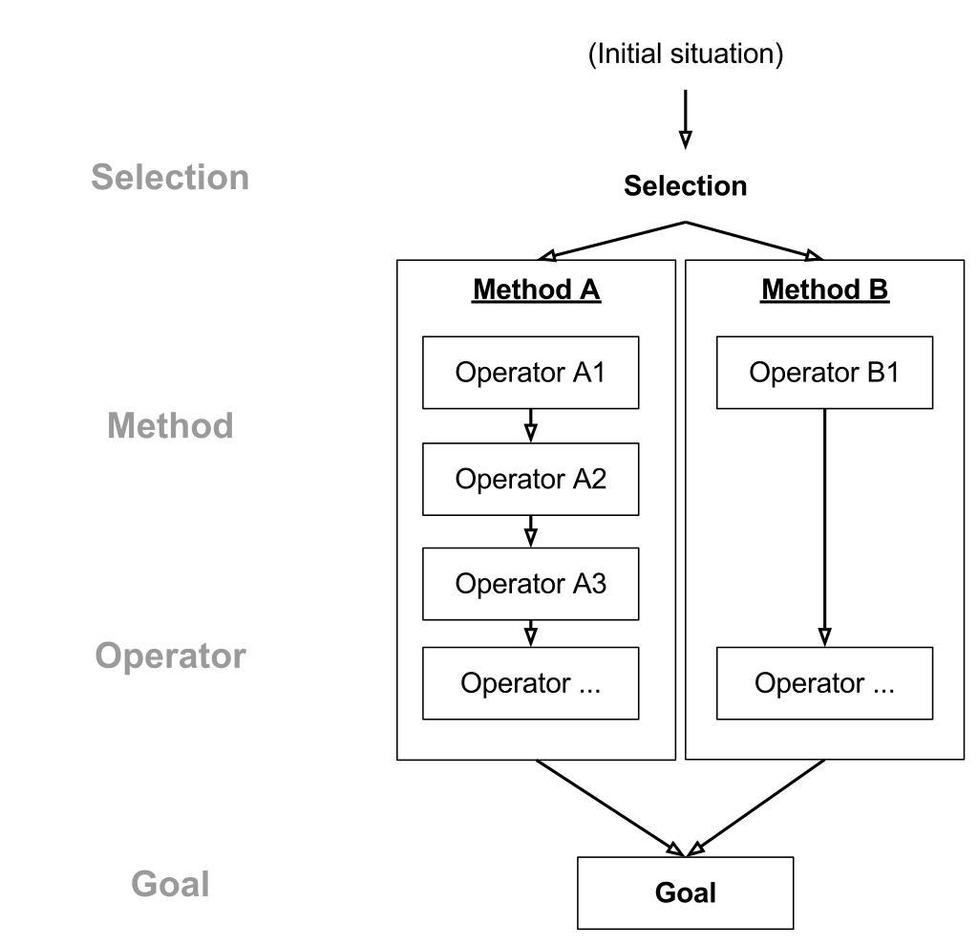
GOMS (Card, Moran, Newell 1983)

Slide 9
GOMS (Card, Moran, Newell 1983)
GOAL SEARCH-FOR-CHI25
OPERATOR move-cursor-to-textbox
OPERATOR click-mouse-button
OPERATOR type-C
OPERATOR type-H
OPERATOR type-I
OPERATOR type-2
OPERATOR type-5
OPERATOR move-cursor-to-search
OPERATOR click-mouse-button

Slide 11
1. Goals
2. Limited resources
3. Representations
4. Adaptation

